Slide 1

BASIC OF CIVIL ENGINEERING (TCE 101)
UNIT- 1 Lect-5

Slide 2
Infrastructure for Nation Development
Civil engineers play a major role in the infrastructures development of a country. All structures constructed in the past exhibit the path of civilization and current infrastructures development express the practices followed by civil engineers.
Infrastructure can be defined as activities that provide society with services necessary to conduct daily life and to engage in productive activity and development in a country’s economy.
ECONOMY ↔ INFRASTRUCTURE

Slide 3
Infrastructure for Nation Development
Energy
Transport
Irrigation
Finance
Communications
Education
Health
ECONOMY ↔ INFRASTRUCTURE
The knowledge of basic areas of civil engineering can be of great use in providing the infrastructural facilities where constructional aspects are involved for development of regions.

Slide 4
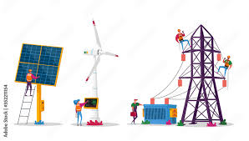
Infrastructure for Nation Development
Energy
Transport
Irrigation
Finance
Communications
Education
Health
Electrical energy is so-far best for transmission of power. Even chemical energy of coal/petrol/ diesel is converted into electrical for long distance transmission .
The construction of dams (for hydro-electric power), wind turbines (for wind energy), nuclear reactors (for nuclear energy), solar power plants, Thermal power plants (for coal/diesel based) requires Civil Engineering
ECONOMY ↔ INFRASTRUCTURE
Also the power produced from all these sources are to be transmitted and distributed to the user through transmission line towers and distribution poles

Slide 5

Infrastructure for Nation Development
Energy
Transport
Irrigation
Finance
Communications
Education
Health
Transportation is a specialization in Civil Engineering
  Roadways
  Railways
  Inland navigation
  Marine transportation
  Airways
ECONOMY ↔ INFRASTRUCTURE

Slide 6
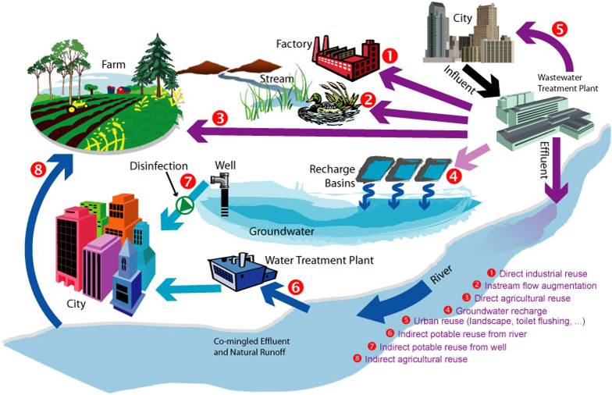
Infrastructure for Nation Development
ECONOMY ↔ INFRASTRUCTURE
Irrigation of agricultural fields and health of human society require supply of water and drainage system
  Construction of dams/ reservoirs
  Canals for distributing the water
  Cross-drainage works
  Water treatment plants
  Pipe network for Water supply
  Sewage disposal and treatment
  Maintenance of River banks for flood control
Energy
Transport
Irrigation
Finance
Communications
Education
Health

Slide 7
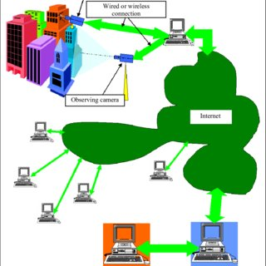
Infrastructure for Nation Development
ECONOMY ↔ INFRASTRUCTURE
Energy
Transport
Irrigation
Finance
Communications
Education
Health
Communication systems and Civil Engineering
  Wired communication
    Fiber optic network
  Wireless Communication
    (microwave towers)
    Satellite launching stations

Slide 8
Infrastructure for Nation Development
Good surface communication links such as tar or concrete rods.
Provision of water supply distribution system i.e. construction of water storage reservation or sumps, laying of underground pipes etc.
Provision of a drainage system which may include construction of surface drains as subsurface drains for the disposal of wastewater.
Supply of electrical power for which construction of transmission line towers, construction of electrical substations.
Providing inland communications lines, i.e telephone lines etc.
Construction of recreational places e.g gardens, parks etc.
ECONOMY ↔ INFRASTRUCTURE

Slide 9
Types and classification of Structures
Buildings
Towers
Chimneys
Bridges
Dams
Retaining Walls
Water Tanks
Silos, Stakes
Cable/Rope Ways
Tunnels
Roads
Railways
Runways
Offshore Structures
Naval Structures
Pipelines
Inland Waterways.

Slide 10
Types and classification of Structures
Buildings: To house people and their things
Towers: To support power transmission lines
Chimneys: To transfer hot gases to a higher altitude
Bridges: To provide access over an obstruction
Dams: To retain water in a valley
Retaining Walls: To retain soil from falling on..
Water Tanks: To retain water for storage
Silos: To store food grains, cement, etc
Cable/Rope Ways: To provide access between hills
Tunnels: To provide access through a hill
Roads: To provide support to moving vehicles
Railways: To provide support to moving trains

Slide 11
Types and classification of Structures
Runways: To support aircraft during takeoff/landing
Offshore Structures: To support machinery over sea
Naval Structures: To support and anchor ships
Pipelines: To provide channel for flow of liquids
Inland Waterway: To provide channel for ships

Slide 12

Types and classification of Structures
Buildings: To house people and their things
Should be stiff and strong
Should be safe under EQ, rain, wind, heat& cold
Should be well ventilated
Should have good lighting
Should support water supply facilities

Slide 13
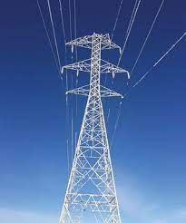
Types and classification of Structures
Towers: To support power transmission lines
At sufficient height. Also for mobile communication from high elevations
Should be high enough for safety to men and animals
Should be stiff and strong
Should be able to resist accident loads
Should not collapse even if adjacent towers collapse

Slide 14
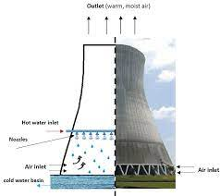
Types and classification of Structures
Chimneys: To transfer hot gases to high altitude
At sufficient height.
Should be high enough so that the gases do not come back
Should be stiff and strong to stand under winds
Should be able to support the water used for cooling

Slide 15
Types and classification of Structures
Home work: Prepare such slides for rest of the structures

Slide 16
Thank you

